Slide 1
Quality management

Slide 2
Quality - definitions
"Quality refers to the degree to which a set of inherent properties meets requirements, where „inherent” is to be understood as „inherent in itself"
ISO 9000:2001
"A certain degree of perfection"
Plato
"Quality is the fulfilment of the requirements "
Crosby
Notes:
Plato: Quality is a judgmental court that marks the degree of perfection in relation to ideas.

Slide 3

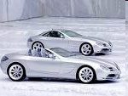
Quality - definitions
Quality = degree to which a set of inherent characteristics of an object fulfils requirements.
Can be: poor, good, excellent.
Sources: www.mmpoznan.pl, www.14tka.com
Notes:
Many definitions of „quality” ☺
The definition on the slide: ISO 9000.

Slide 4

Quality - definitions
Quality = fulfillment of the Customer’s expectations.
Customer = King ☺
Source: https://hx.systems/e/want-become-reseller-hx-systems/customer-king/
Notes:
Philip B. Crosby (author of the "zero defects” theory). Quality = compliance with customer’s requirements (not „abstract perfection” requirements).

Slide 5

Quality management
Quality management = managing the processes of analyzing and assessing the differences between the actual and desired state (norm) and improving quality.
Source: korespondentdrogowy.pl

Slide 6


The genesis of the increase in the importance of quality
  Management through/by production - maximization of production
  Management by marketing - creating and
  satisfying the needs of the recipient
  Quality management - a comprehensive approach to quality in the organization and its environment - this complexity results from the fact that the quality of final products is determined by the activity of all subsystems of the organization and the situation in its environment.
Sources: www.automotogaleria.pl, www.reghardware.co.uk,
Notes:
The importance of quality increased along with changes in the management of manufacturing organizations.

Slide 7
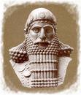
The origins of quality management ☺
Sources: enjpro.info, Pacholarz, Bucki, Perception and understanding of quality in Deming’s management theory... and quality process improvement in education
Notes:
The origin of the issue of quality dates to the beginning of the world. In the Bible (in the Book of Genesis) in the description of the creation of the world one can find certain elements of it (God knew that everything he did was very good), i.e. distinguishing things better (good) and worse (bad ones). Other records on this issue can be found in the Hammurabi Code (If a builder built a house and his work was not done permanently and the house he built collapsed and killed the owner, the builder will be punished with death), Chinese Chronicles of Ethics (Tools below standards cannot be marketed, cotton and silk whose quality and size do not have the required parameters, cannot be marketed) or Phoenician legislation (In case of re-identification of poor quality handicraft products, its makers must cut their hands) (Ostasiewicz [ed.], 2004, p. 110). Thus, the sources of quality of goods and services should be seen in times of great civilizations such as Egyptians, Mesopotamians, Israelites, Romans, Greeks, Chinese, or even Hindus. Literature of the subject indicates that in the era of classical Greek philosophy (5th–4th c. BC), i.e. in the second decade of the development of ancient philosophy (Plato’s work), the term ‘quality’ first appeared. In his work Symposium Plato recognized that the real world was an imperfect reflection of realistically perfect ideas. According to this conviction, the author has defined ‘quality’ as a certain degree of perfection (objective idealism), stating that quality as beauty is a judgment expressed by the user. If there is no user, then there is no such court

Slide 8


Quality management systems – history ☺
Sources: www.eszkola.pl, www.e2cweb.com
Notes:
A turning point in the history of quality occurred in Japan shortly after the end of WWII. Japanese industry was destroyed and had to be rebuilt from scratch. A number of Americans went to help. They taught, among others, using statistics to control the production process.

Slide 9



Quality management systems – history ☺
W. Edwards Deming
statistical process control (controlled and uncontrolled variations)
14 points of management
Joseph Juran
„quality trilogy”
plan, control, improve
Kaoru Ishikawa
quality circles
Sources: www.balancedscorecard.org, www.timesonline.co.uk, www.lean-sigma.com.pl
Notes:
One of them was W. Edwards Deming (he went to Japan in 1950). First photo on the left. Appreciating what Deming did to rebuild its production system after the war, Japan named its highest quality award after him. The prestigious Deming Award, established in 1951, is regarded as a symbol of Japanese concern for high quality. Statistical process control - controlled variations (regarding the process itself) and uncontrolled variations (changes in raw material, external interference) affect the quality. First, uncontrolled variations should be eliminated, and controlled variations removed by designing and modifying the system. Joseph Juran - came to Japan around the same time as Deming. He also participated in the development of statistical process control. Juran and Deming's ideas are similar, but while Deming thought that focusing on quality requires revolutionary changes and preached the philosophy of implementing great changes, Juran thought that high quality could be introduced like any other changes in the company, using the company's decision and action planning system (its "trilogy" - plan quality, control quality, improve quality, is similar to, e.g.: financial planning, financial control and increasing profits).
Kaoru Ishikawa - Japanese specialist. Co-creator of quality circles - working groups in which workers meet to discuss suggestions for improvement. The Americans tried to copy them, but they did not understand that the Japanese really took the workers' proposals seriously and implemented them (and before that they acquainted both workers and managers with the tools and philosophy of achieving quality). Ishikawa also emphasized focusing all efforts on clients in the pursuit of comprehensive quality. He even went so far that he proposed to treat the next department, to which the production of his department is transferred as a customer.

Slide 10
14 points for management
1. Create constancy of purpose for improvement of product and service.
The point stresses the need for a mission statement which must be understood by all employees, suppliers, and customers. The strategic plan should look for the longterm payback.
2. Adopt the new philosophy.
Management must learn the responsibilities and take on leadership for change. Poor workmanship, defective products, or bad service are not acceptable.

Slide 11
14 points for management
3. Cease dependence on mass inspection.
Eliminate the need for inspection on a mass basis by building quality into the product in the first place. Statistical methods of quality control are more efficient.
4. End the practice of awarding business on the basis of price tag alone.
Instead, minimize the total cost. The aim in the purchase of new tools and other equipment should be to minimize the net cost per hour of operation or per piece produced. Move toward a single supplier for any one item, on a long-term relationship of loyalty and trust.

Slide 12
14 points for management
5. Improve constantly and forever the system of production and service.
The improvement of product and service is an ongoing process. The Deming cycle involves the four-step process of plan, do, check, act. At the plan stage, the opportunities for improvement are identified. The theory is tested on a small scale at the do stage, the results of the test are analyzed at the check stage, and the results are implemented in the act stage.
6. Institute training.
On-the-job training must be provided for all employees. Employees must be encouraged to implement the knowledge developed through training.

Slide 13
14 points for management
7. Adopt and institute leadership.
The aim of supervision should be to help people to do a better job using machines. Supervision must create an environment where the workers take leadership roles in accomplishing their work.
8. Drive out fear.
Management must create an environment where workers are encouraged to ask questions and make suggestions. A climate of innovation leads to progress.

Slide 14
14 points for management
9. Break down barriers between departments.
People in research, design, material procurement, sales, and production must work as a team. They must understand the requirements and specifications. Teamwork leads to improvements in quality and productivity.
10. Eliminate slogans, exhortations, and targets for the work force.
Exhortations such as asking for zero defects and new levels of productivity only create adversarial relationships. The bulk of the causes of low quality and low productivity belong to the system and thus lie beyond the power of the work force.

Slide 15
14 points for management
11. Eliminate numerical quotas for the work force and eliminate numerical goals for people in management.
Quotas lead to the deterioration of quality. Learn the capabilities of processes and methods to improve them.
12. Remove barriers that rob people of pride of workmanship.
Quality is achieved in the company when all employees are satisfied and motivated. Management must create an environment where the workers take pride in their job.

Slide 16
14 points for management
13. Encourage education and self-improvement for everyone.
An organization needs people that are improving with education.
14. Take action to accomplish the transformation.
The transformation is everybody’s job.

Slide 17
W. Edwards Deming
„80 - 85% of the problems of each organization have their sources in
systems,
and only 15 – 20 % are with
workers.”

Slide 18
W. Edwards Deming
Deming’s deadly diseases
1. Lack of constancy of purpose
2. Emphasis on short-term profits
3. Evaluation of performance, merit rating, or annual review
4. Mobility of top management
5. Running a company on visible figures alone (counting the money)
6 & 7
These are not reproduced here. They relate to excessive medical and warranty costs and were considered by Deming to be essentially American phenomena.
6. Excessive medical costs
Notes:
Deming’s seven deadly diseases
(From Deming 1982 ‘Out of the Crisis’ Chapter 3)
1. Lack of constancy of purpose
Constancy of purpose – the first of the Fourteen Points – is essential to stay in business. Its absence spells doom for a company. Without constancy of purpose, management does not think beyond the next quarter and has no long-range plans for staying in business.
Dedication to the new philosophy must be widespread throughout the company. It is not sufficient to announce intentions to improve quality, even repeatedly. Employees in many companies have been exposed to a succession of plans for improvement. They have seen programmes come and go, often coinciding with the term of the chief executive; a new boss, a new programme. Disenchanted and disillusioned, they require proof that the company is serious.
2. Emphasis on short-term profits
Todays organisations are often controlled by financial people who manipulate figures but do not make substantial changes to production and quality. They are driven by what they argue are the needs of the shareholders. Shareholders who depend on dividends for income need to be assured that their company will still be in existence, and still be producing dividends, some years hence. It is common for companies to ship products (or take other actions) on the last day of the month, without regard to quality, merely to inflate the figures.
Paper profits do not make the pie bigger, Dr Deming was fond of saying. They give you a bigger price. You take it from somebody else. It doesn’t help the society.
3. Evaluation of performance, merit rating, or annual review
Management by objective (MBO) programmes and management by the numbers fall in this category. Management by fear would be a better name, suggests Dr Deming. The effects are devastating.
First, performance evaluation encourages short-term performance at the expense of long-term planning. It discourages risk-taking, builds fear, undermines teamwork, and pits people against each other for the same rewards. On a team, it is difficult to tell who did what. The result is a company composed of prima donnas or sparring fiefdoms. People work for themselves, not the company.
Such evaluations, Dr Deming says, leave people bitter, despondent, dejected, some even depressed. They are unfit for work for weeks after receipt of rating, unable to comprehend why they are inferior. It is unfair, as it ascribes to the people in a group differences that may be caused totally by the system that they work in.
He notes that merit ratings tend to increase variability of performance, as people with lower ratings attempt to emulate those with higher ones.
An insidious effect if that they also increase reliance on numbers. Because they measure short-term results, there is a tendency to consider only evidence that can be counted. The number of designs an engineer turns out, for example, with no consideration of their quality. Merit ratings also depend on the subjective judgement of supervisors. One’s rating may vary wildly, depending on the boss.
Some supervisors dread making the judgements. One popular system requires them to assign ratings from one to five, with a certain number of people at each level. Even when there are only five workers, one must be rated at the top and one at the bottom.
The great accomplishments of man, Dr Deming says, have been achieved without competition.
Look at Moses. He had no competition. Two hundred years ago Sebastian Bach was writing the rules of harmony for all time. Why did he do it? Pride of workmanship.
Dr Deming feels very strongly about the damage done by performance ratings. In his speech at the 11 December 1985 Deming Prize awards ceremony in Japan, Dr Deming cautioned his listeners against infection with American diseases. He talked at length about performance ratings. His audience, of course, was familiar with the use of control charts to determine statistical limits.
The ratings of people in a group based on any numerical system whatever, whether it be a single measure of whether it be a composite or weighted index, whether it makes sense or not, will divide the people into three groups. A) People outside the control limits on the bad side; B) People outside limits on the good side; C) the people between limits.
Group A requires individual help. Group B, if there’s anybody there – there may not be anybody in A or B – but if there is, they require individual attention. Now, people in between the control limits must not be ranked. That is wrong, for the same reason that it is costly, devastating to try to discover the reasons why a point within control limits is higher than another one, or lower than another one. Differences within levels between the limits come from the system itself, not from the people there. Everybody in group C should receive the same increase in pay or the same bonus. There is no rightful distinction between them. The differences come from the system. They must be ascribed to the system, not to the people.
The job of the leader is to shrink the control limits, to get less and less variation in a process, or less and less difference between people.
4. Mobility of top management
Business schools are dedicated to the idea that you can train a good manager in university applicable techniques. But how can a manager be committed to long-term change when he is constantly building up his curriculum vitae? How can a manager really know a company when he is there for only two or three years? In Japan, executives move through the ranks in a progression that takes decades to push them to the top.
Dr Deming quotes J. Noguchi, managing director of the Union of Japanese Scientists and Engineers, as saying, America cannot make it because of mobility of American management. Says Dr Deming, Mobility from one company to another creates prima donnas for quick results. People require time to learn to work together.
Mobility of labour in America, he adds, is almost as serious a problem. The principal cause is dissatisfaction with the job.
5. Running a company on visible figures alone (counting the money)
Visible figures are important, of course. There is a payroll to meet, suppliers to pay, taxes to pay, and so on. But, says Dr Deming, in a formulation for which he credits Lloyd S. Nelson of Nashua Corporation, the figures that are unknown and unknowable are even more important.
It is impossible, for example, to measure the effect on sales of a happy customer or the gains in quality that result from ridding a company of the Deadly Diseases. Only in time will these results become apparent.
6 & 7
These are not reproduced here. They relate to excessive medical and warranty costs and were considered by Deming to be essentially American phenomena.
6. Excessive medical costs
As William E. Hoglund, manager of the Pontiac Motor Division, put it to me one day, “Blue Cross is our second largest supplier.” The direct cost of medical care is $400 per automobile (“Sick call,” Forbes, 24 October 1983, p116). Six months later he told me that Blue Cross had overtaken steel. This is not all. Additional medical costs are embedded in the steel that goes into an automobile. There are also direct costs of health and care, as from beneficial days (payment of wages and salaries to people under treatment for injury on the job); also for counselling of people depressed from low rating on annual performance, plus counsel and treatment of employees whose performance is impaired by alcohol or drugs.
7. Excessive costs of liability, swelled by lawyers that work on contingency fees(Eugene L Grant, interview in the journal Quality (Chicago), March 1984).
Conclusion:
Throughout his long working life, Deming held and expressed forthright views on what he saw as the ills of Western management. Here are some direct quotations.
If management were to spend as much existing time to improve processes as they do in ranking, rating, reward and punishment for people (teams, departments, divisions) at the top and at the bottom the results would be stupendous improvement of our economic position.”
The biggest problem that almost any company in the Western world faces is not its competitors, nor the Japanese. The biggest problems are self inflicted, created right at home by management that is off course …”

Slide 19
Total Quality Management (TQM)
Total Quality Management =
a management system for a customer-focused organization that involves all employees in continual improvement. It uses strategy, data, and effective communications to integrate the quality discipline into the culture and activities of the organization.

Slide 20
TQM – basic rules
Continuous improvement (of processes, staff, products and components)
Very strong cooperation between all participants of the quality management process
System thinking
Focusing on customers
The role of management
Employee participation

Slide 21
Total Quality Management (TQM)
Teams
Customer
Supplier
Culture
Communication
Involvement
Systems
Tools
Notes:
The basis of TQM's activities is the customer-supplier chain, supplemented by: Hard elements (assemblies, systems and tools) Soft elements (culture, communication, commitment).

Slide 22
Methods supporting TQM
concept of cost of quality (COQ)
the "zero defects" concept
Ishikawa diagram
5S method
Kaizen concept
JiT system
Six Sigma method

Slide 23
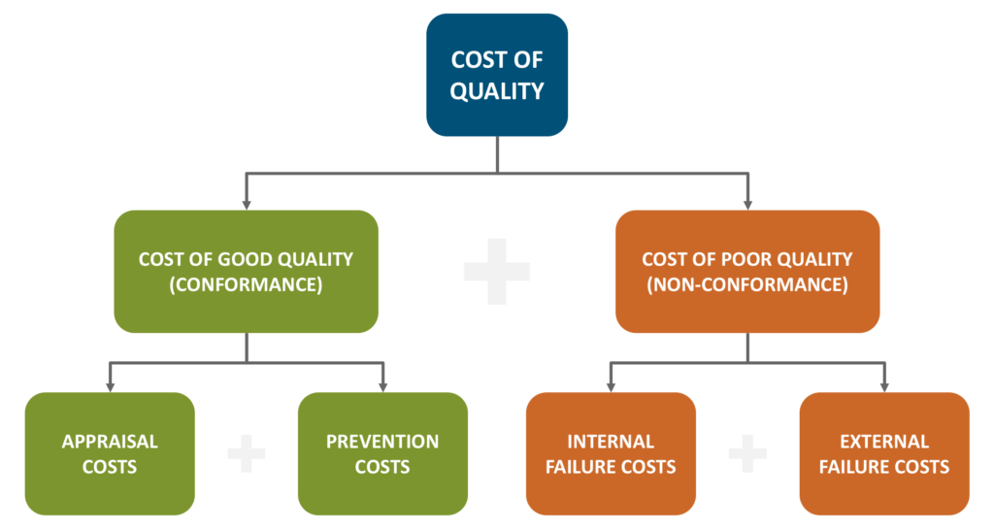
Cost of Quality (COQ)
Source: https://massaroconsulting.com/2017/10/cost-of-quality/
Notes:
The Cost of Good Quality (CoGQ)
Prevention Costs – costs incurred from activities intended to keep failures to a minimum. These can include, but are not limited to, the following:
Establishing Product Specifications
Quality Planning
New Product Development and Testing
Development of a Quality Management System (QMS)
Proper Employee Training
Appraisal Costs – costs incurred to maintain acceptable product quality levels. Appraisal costs can include, but are not limited to, the following:
Incoming Material Inspections
Process Controls
Check Fixtures
Quality Audits
Supplier Assessments
The Cost of Poor Quality (CoPQ)
Internal Failures – costs associated with defects found before the product or service reaches the customer. Internal Failures may include, but are not limited to, the following examples:
Excessive Scrap
Product Re-work
Waste due to poorly designed processes
Machine breakdown due to improper maintenance
Costs associated with failure analysis
External Failures – costs associated with defects found after the customer receives the product or service. External Failures may include, but are not limited to, the following examples:
Service and Repair Costs
Warranty Claims
Customer Complaints
Product or Material Returns
Incorrect Sales Orders
Incomplete BOMs
Shipping Damage due to Inadequate Packaging

Slide 24

„Zero defects” concept
Philip Crosby – 4 major principles:
The definition of quality is conformance to requirements (requirements meaning both the product and the customer's requirements)
The system of quality is prevention
The performance standard is zero defects (relative to requirements)
The measurement of quality is the price of nonconformance
Quality is free
Source: www.wppl.org
Notes:
Philip B. Crosby - a businessman and author who influenced quality improvement through his writings and lectures. He started the Crosby Associates, which provides consulting and training in quality management. In his book Quality Is Free, Crosby provides a detailed quality management grid which provides various stages of management understanding and attitude, quality organization status, problem handling, cost of quality in relation to sales, quality improvement actions, and company quality posture. Crosby’s response to the quality crisis was the principle of “doing it right the first time.” The concept of zero defects was ahead of its time. More recently the concept of zero defects has led to the creation and development of Six Sigma, pioneered by Motorola, which has since been adopted worldwide by many other organizations.

Slide 25
Ishikawa diagram
Manpower
Material
Result
(Quality)
Machine
Method
Management

Slide 26
Example: faulty bearing
Steel bars with incorrect dimensions
Manpower
Materiał
Insufficient training
Incorrect carbon content in steel
Faulty bearing
High power variability
Incorrect calibration
Wrong production programming
Machine
Method
Management
Frequent failures
Defective automatic power supply speed
Notes:
Also called „fishbone” or „the cause and effect” diagram. It helps systematize the possible causes of the problem.

Slide 27
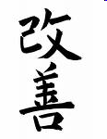
Kaizen
Kaizen = a strategy of continuous improvement
Success involvement of all levels of the organization hierarchy
Source: shinsokai.files.wordpress.com
Notes:
The kaizen philosophy, mentioned above is one of the most widely spread change management theories, based on the assumption that one can improve the functioning of an organization in an evolutionary way, in small steps, thanks to the involvement of all the workers who should be trying to spot the so-called muda (waste) and come up with suggestions of rationalization, never ending their efforts to seek perfection. The very word is derived from two Japanese words: kai (change) and zen (good), thus kaizen can be translated as “change for better”. The concept was popularized by Masaaki Imai, a Japanese management writer, author of worldwide bestsellers, the best known being: Kaizen: The key to Japan's competitive success (Imai, 1986) and Gemba Kaizen: A Commonsense, Low-Cost Approach to Management (Imai, 1997). The company that is a world-famous symbol of the success of the kaizen approach is Toyota, a Japanese car manufacturer. It has even worked out a unique quality assurance instrument – TPS (Toyota Production System) (Krasiński, 2014, p. 19). The kaizen approach, however, has been successfully implemented in thousands of companies, not only in Japan but throughout the world, in various branches of industry. Examples include not only manufacturing or logistics, but also healthcare, retail and services (Kaizen Institute, 2015b).
It is important to stress here that the very notion kaizen can be understood in a number of ways. Above all, it is a philosophy, or a way of life, so very much Far-Eastern one, based on Confucianism and Zen Buddhism (Krasiński, 2014, p. 16). As Imai has it, “In Japanese, kaizen means continuous improvement. The word implies improvement that involves everyone - both managers and workers - and entails relatively little expenses. The kaizen philosophy assumes that our way of life - be it our working life, our social life, or our home life - should focus on constant improvement efforts. This concept is so natural and obvious to many Japanese that they don't even realize they possess it! In my opinion, kaizen has contributed greatly to Japan's competitive success.” (Imai, 1997, p. 3).
However, kaizen can also serve as an “umbrella concept” for a set of “uniquely Japanese” quality management tools, which include, among others, total quality control (TQC), quality circles, the Japanese style of labor relations, just-in-time (JIT) or the suggestion system (ibidem).
In a nutshell, Confucianism is a system of values created by a Chinese scholar, Kong Qiu (551 – 479 B.C.). It became known in Japan in V-VI c. A.D. The five basic ethical rules of Confucianism are: ren (humanity, goodness, benevolence), yi (righteousness), li (proper conduct), zhi (wisdom) and xin (faithfulness). (Charkiewicz, 2008, pp. 63, 64).

Slide 28
Kaizen
Glossary (examples):
Gemba
A Japanese word that means "the real place". Used in the context of KAIZEN™, Gemba usually refers to the place where value is added, such as the shop floor or frontline. In a broader sense, Gemba refers to any place in an organization where work is being performed; thus one may have an engineering Gemba, a sales Gemba, an accounting Gemba, etc. Management must go to Gemba to understand the people, processes, products and problems.

Slide 29
Kaizen
Kanban
A materials (or information) replenishment planning tool in a Just-in-Time production and inventory control system developed by Toyota. KANBAN is often seen as a central element of a Pull system. The root meaning of KANBAN is a visual sign (Kan = card; Ban = signal). On the basis of automatic replenishment (through signal cards that indicate when more materials or information are needed) the flow of materials and information throughout the system (suppliers, within the value stream, and the customers), is regulated. Also known as "Kamban".

Slide 30
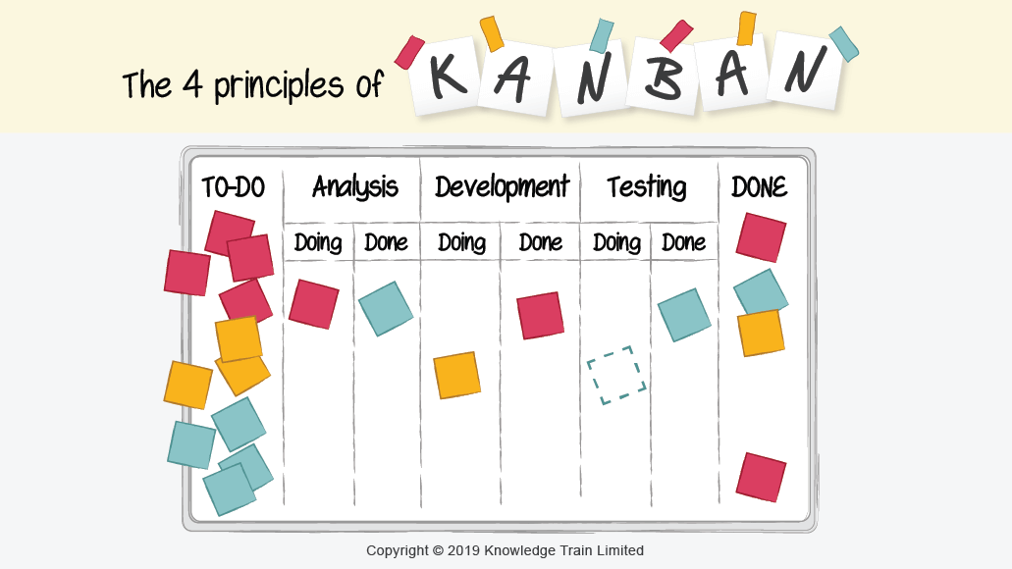
Kaizen
Source: https://www.knowledgetrain.co.uk/agile/kanban-principles

Slide 31
Kaizen
Quality circles
Quality improvement teams of 10 or fewer employees. They carry out voluntary and continuous activities aimed at improving the workplace.

Slide 32
Kaizen - muda
Muda:
Japanese word for "Waste”. Muda is any non-value adding activity, or a task a customer is not willing to pay for.
Muda-Walk
A walk through Gemba to observe evidence of what may be various types of Muda. The object of this walk is to show that the Gemba is full of opportunities for improvement for those whose eyes are trained to see them. Muda walks are not intended to blame and shame or to finding fault but to gather data about the status of the process and the people. A waste observation walk must be based on respect for people.
Notes:
Contrasted to the traditional tendency to ask "Who?" and to blame people for problems and mistakes, this approach looks at the problem with others to seek a solution. Also implicit in this principle is an approach of childlike curiosity about how things work and how they can be improved, instead of judging whether people did a good or bad job; if they are right or wrong. The principle does not imply that managers must never exercise judgment, since good judgment is always required in decision-making.
Toyota has developed its production system around eliminating three enemies of Lean: Muda (waste), Muri (overburden) and Mura (unevenness) (Liker, 2004).
Muda is the direct obstacle of flow. As written below, there are 8 distinctive types of muda which all lead to waiting times, and therefore longer lead times in a process. Simply taking out the muda does not work. Usually, there is a reason why the muda is there and this reason often has to do with the other two enemies: muri and mura.

Slide 33
Kaizen - muda
Overproduction
Overproduction occurs when manufacturing a product or an element of the product before it is being asked for or required. It may be tempting to produce as many products as possible when there is idle worker or equipment time. However, rather than producing products just when they are needed under the ‘Just In Time’ philosophy, the ‘Just In Case’ way of working leads a host of problems including preventing smooth flow of work, higher storage costs, hiding defects inside the WIP, requiring more capital expenditure to fund the production process, and excessive lead-time. Additionally, over-producing a product also leads to an increase in likelihood that the product or quantities of products produced are beyond the customer’s requirements.
In an office environment, overproduction could include making extra copies, creating reports no one reads, providing more information than needed, and providing a service before the customer is ready. Manufacturing overproduction involves producing more products than demanded through a ‘push production system’ or producing products in higher batch sizes than needed.
Source: https://theleanway.net/The-8-Wastes-of-Lean
Notes:
There are three countermeasures for overproduction. Firstly, using a ‘Takt Time’ ensures that the rate of manufacturing between stations are even. Secondly, reducing setup times enables manufacturing small batches or single-piece flow. Thirdly, using a pull or ‘Kanban’ system can control the amount of WIP (Work In Progress).

Slide 34
Kaizen - muda
Defects
Defects occurs when the product is not fit for use. This typically results in either reworking or scrapping the product. Both results are wasteful as they add additional costs to the operations without delivering any value to the customer.
Source: https://theleanway.net/The-8-Wastes-of-Lean
Notes:
Some countermeasures for waiting include: designing processes to ensure continuous flow or single piece flow, leveling out the workload by using standardized work instructions, and developing flexible multi-skilled workers who can quickly adjust in the work demands.

Slide 35
Kaizen - muda
Inventory
It is often difficult to think about excess inventory as waste. In accounting, inventory is seen as an asset and often suppliers give discount for bulk purchases. But having more inventory than necessary to sustain a steady flow of work can lead to problems including: product defects or damage materials, greater lead time in the production process, an inefficient allocation of capital, and problems being hidden away in the inventory. Excess inventory can be caused by over-purchasing, overproducing work in process (WIP), or producing more products than the customer needs. Excess inventory prevents detecting production-related problems since defects have time to accumulate before it is discovered. As a result, more work will be needed to correct the defects.
In-office inventory waste could be files waiting to be worked on, customers waiting for service, unused records in a database, or obsolete files. Manufacturing inventory waste could include broken machines sitting around, more finished products than demanded, extra materials taking up work space, and finished products that cannot be sold.
Source: https://theleanway.net/The-8-Wastes-of-Lean
Notes:
Some countermeasures for inventory include: purchasing raw materials only when needed and in the quantity needed, reducing buffers between production steps, and creating a queue system to prevent overproduction.

Slide 36
Kaizen - muda
Motion
The waste in motion includes any unnecessary movement of people, equipment, or machinery. This includes walking, lifting, reaching, bending, stretching, and moving. Tasks that require excessive motion should be redesigned to enhance the work of personnel and increase the health and safety levels.
In the office, wasted motion can include walking, reaching to get materials, searching for files, sifting through inventory to find what is needed, excess mouse clicks, and double entry of data. Manufacturing motion waste can include repetitive movements that do not add value to the customer, reaching for materials, walking to get a tool or materials, and readjusting a component after it has been installed.
Source: https://theleanway.net/The-8-Wastes-of-Lean
Notes:
Some countermeasures for motion include making sure the workspace is well organized, placing equipment near the production location, and putting materials at an ergonomic position to reduce stretching and straining.

Slide 37
Kaizen - muda
Skills - The 8th Waste
Even though it was not part of the Toyota Production System (TPS), many people are well aware of the 8th waste - the waste of human potential. The 8th waste is also described as the waste of unused human talent and ingenuity. This waste occurs when organizations separate the role of management from employees. In some organizations, management’s responsibility is planning, organizing, controlling, and innovating the production process. The employee’s role is to simply follow orders and execute the work as planned. By not engaging the frontline worker’s knowledge and expertise, it is difficult to improve processes. This is due to the fact that the people doing the work are the ones who are most capable of identifying problems and developing solutions for them. In the office, non-utilized talent could include insufficient training, poor incentives, not asking for employee feedback, and placing employees in positions below their skills and qualifications. In manufacturing, this waste can be seen when employees are poorly trained, employees not knowing how to effectively operate equipment, when employees are given the wrong tool for the job, and when employees are not challenged to come up with ideas to improve the work.
Source: https://theleanway.net/The-8-Wastes-of-Lean

Slide 38
Kaizen - muda
Over-processing
Over-processing refers to doing more work, adding more components, or having more steps in a product or service than what is required by the customer. In manufacturing this could include using a higher precision equipment than necessary, using components with capacities beyond what is required, running more analysis than needed, over-engineering a solution, adjusting a component after it has already been installed, and having more functionalities in a product than needed. In the office, over-processing can include generating more detailed reports than needed, having unnecessary steps in the purchasing process, requiring unnecessary signatures on a document, double entry of data, requiring more forms than needed, and having an extra step in a workflow.
Source: https://theleanway.net/The-8-Wastes-of-Lean
Notes:
One simple way to counter over-processing is to understand the work requirements from the standpoint of the customer. Always have a customer in mind before starting work, produce to the level of quality and expectation that the customer desires, and make only the quantities needed.

Slide 39
Kaizen - muda
Transport
Waste in transportation includes movement of people, tools, inventory, equipment, or products further than necessary. Excessive movement of materials can lead to product damage and defects. Additionally, excessive movement of people and equipment can lead to unnecessary work, greater wear and tear, and exhaustion.
In the office, workers who collaborate with each other often should be close together. In the factory, materials necessary for production should be easily accessible at the production location and double or triple handling of materials should be avoided.
Source: https://theleanway.net/The-8-Wastes-of-Lean
Notes:
Some of the countermeasures to transportation waste includes developing a U-shape production line, creating flow between processes, and not over-producing work in process (WIP) items.

Slide 40
Kaizen - muda
Waiting
The waste of waiting includes: 1) people waiting on material or equipment and 2) idle equipment. Waiting time is often caused by unevenness in the production stations and can result in excess inventory and overproduction.
In the office, waiting waste can include waiting for others to respond to an email, having files waiting for review, ineffective meetings, and waiting for the computer to load a program. In the manufacturing facility, waiting waste can include waiting for materials to arrive, waiting for the proper instructions to start manufacturing, and having equipment with insufficient capacity.
Source: https://theleanway.net/The-8-Wastes-of-Lean
Notes:
Some countermeasures for waiting include: designing processes to ensure continuous flow or single piece flow, leveling out the workload by using standardized work instructions, and developing flexible multi-skilled workers who can quickly adjust in the work demands.

Slide 41
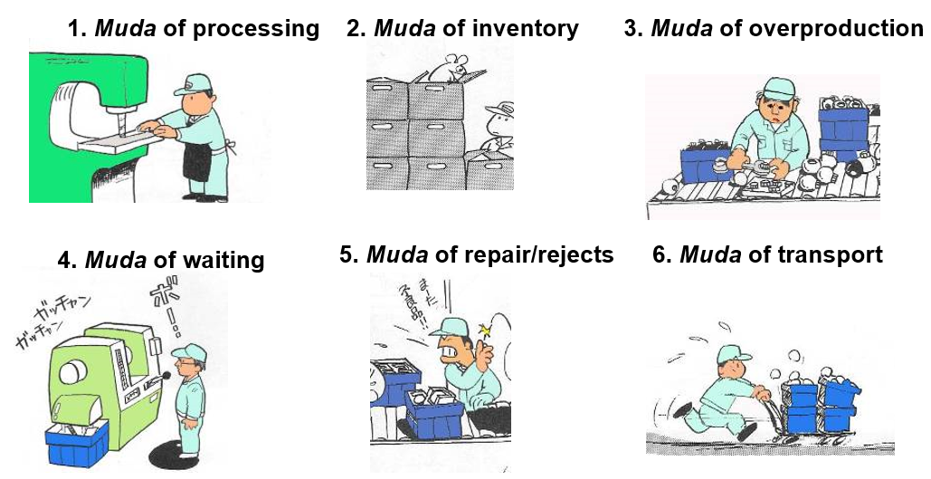
Kaizen - muda
Source: https://takuminotie.com/english/wp-content/uploads/sites/3/2015/02/kaizen11.png

Slide 42
Kaizen
Suggestion system –
a system typical of Japan for submitting proposals to improve the organization's activities by employees, based on a positive attitude of employees to their workplace rather than (Western European) orientation on economic benefits.

Slide 43
5S Method
A methodology that results in a workplace that is clean, uncluttered, safe, and well organized to help reduce waste and optimize productivity.
SEIRI - sort
SEITON – set in order
SEISO – sweep, shine
SEIKETSU – stabilize, standardize
SHISUKE – self-discipline, sustain
Notes:
5S is a simple but powerful tool for organizing a workplace in a clean, efficient and safe manner to enhance productivity, visual management and to ensure the introduction of standardized working. The main purpose of 5S is to support the efficient flow of materials, information and people; not to beautify the workplace.
5S Seiri; Sort, Clearing, Classify
5S Seiton; Straighten, Simplify, Set in Order
5S Seiso; Sweep, Shine, Scrub, Clean and Check
5S Seiketsu; Standardize, Stabilize, Conformity
5S Shitsuke; Sustain, Self Discipline, Standardization

Slide 44
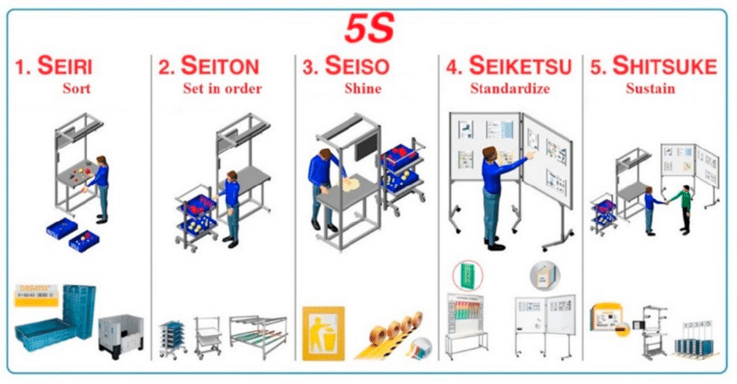
5S Method
Source: https://www.researchgate.net/publication/324202036_Case_study_concerning_5S_method_impact_in_an_automotive_company/figures?lo=1

Slide 45


5S Method
Source: https://www.sesa-systems.co.uk/method-5s-approach-for-an-organized-environment

Slide 46

Kaizen outside Japan? Kaizen in Poland?
Source: https://www.123rf.com/photo_82522466_portrait-of-a-smiling-male-janitor-cleaning-desk-with-cloth-at-workplace.html
Notes:
There were undertaken efforts to implement the Japanese management concepts, methods and instruments in subsidiaries of Japanese companies that were set up in Poland or in Polish companies that were accepted as suppliers or subcontractors for the Japanese partners. They included, e.g. the above mentioned tools from the “kaizen-umbrella” (such as kaizen, kanban or quality circles) as well as some others, e.g. hoshin kanri, a Japanese strategic management method which involves all the company members and processes (Ćwiklicki, Obora, 2011).
As one might expect, the introduction of Japanese working culture and methods, shaped by a Far-Eastern, Confucian society in Polish subsidiaries evoked some difficulties. For example, according to studies conducted by Dr Marek Krasiński from Wroclaw University of Economics (Krasiński, 2014) there were observed a number of cultural differences that had a significant impact on the quality of work and working relations of Polish workers and their Japanese superiors. It is worth mentioning here that, as one might expect, the introduction of Japanese working culture in companies operating abroad is a challenge not only in Poland. A Japanese scientist, Professor Katsuo Yamazaki made research in 114 foreign firm, located in 25 countries (e.g. Russia, Malaysia, Argentina, Vietnam, USA, Hungary and Sweden), operating in 13 industries (ranging from automotive components, transportation machines, electronic components to oil and gas, chemical and rubber products). He made an attempt to examine factors that determine the success or failure in overseas Japanese subsidiaries. He studied, among others, the adoption of an instrument that can be considered as kaizen - 5S (a workplace organization method which uses five Japanese words: Seiri, Seiton, Seiketsu, Seiso and Shitsuke, which can be translated in English as: arrangement, order, cleanliness, cleanup and discipline). Yamazaki noticed that “It is by no means an easy task to spread values deeply rooted in Japanese culture in foreigners’ behavior. This is especially true in Europe and the USA, where the division of labor is advanced and Seiso, or cleanup, is taken as a job of those who are professionally employed to do such work. It is believed to have nothing to do with site operators.” (Yamazaki, 2012, pp. 173, 174). Another example of a problematic issue can be the Japanese time-consuming group decision-making process. An international management expert, Tim Keeley, who studied the practices of human resource management in a number of Japanese subsidiaries, observed that, as far as decision- making was concerned “the two main issues were frustration in relation to how long it takes to make some decisions and the lack of individual decision making authority” (Keeley, 2001, p. 204).

Slide 47

Kaizen outside Japan? Kaizen in Poland?
Source: https://www.creativesafetysupply.com/articles/quality-circle/
Notes:
Studies conducted in a number of companies operating in Poland that either are subsidiaries or subcontractors of Japanese organizations let their author to formulate the following conclusion: Japanese management concepts, methods and instruments are implemented in Polish companies, but in forms adapted to Polish cultural conditions. For example one can organize Quality Circles in Polish companies, but, unlike in Japan, workers will expect extra payment for participation in meetings of the Circles. They do not treat work in Quality Circles or coming up with suggestions of improvements as their duty, either. Polish workers also prefer a payment system related to the real results of their work to a system based on the seniority rule (Krasiński, 2014, p. 130).
One should remember, however, that – as in the case of all stereotypes – values and attitudes generally attributed to the Japanese do not necessarily characterize the whole nation and country. Japan is not a monolith and is also undergoing changes. As Karpoluk (2012, pp. 76-77) notices, the picture of a crowd of commuters in dark suits, flowing out of the subway and disappearing into the skyscrapers is typical of a few big cities only. Many young people dream of careers in the arts. The majority of workers are employed on part-time, not full-time basis (a large number of young people look for the so-called baito – temporary, though quite well-paid jobs), and it seems that the guarantees of lifelong employment are a thing of the past.
Karpoluk J. (2012), Kłopoty z Japonią, „Dialog”, no. 2, January, pp.75-86
Keeley T. (2001), International Human Resource Management in Japanese Firms. Their Greatest Challenge, Palgrave Macmillan
Kisielnicki J. (2008), Zarządzanie. Jak zarządzać i być zarządzanym, PWE, Warsaw
Krasiński M.(2014), Kulturowe uwarunkowania wykorzystania japońskich koncepcji, metod i technik zarządzania, Wydawnictwo Uniwersytetu Ekonomicznego we Wrocławiu, Wrocław

Slide 48

Just in Time (JiT)
Demand start of production
Kaizen
Keeping equipment in perfect condition
Elimination of unnecessary inventory and storage space
Increasing the number of deliveries
Source: www.solar-polska.pl
Notes:
The just-in-time (JIT) inventory system is a management strategy that minimizes inventory and increases efficiency.
Just-in-time (JIT) manufacturing is also known as the Toyota Production System (TPS) because the car manufacturer Toyota adopted the system in the 1970s.
Kanban is a scheduling system often used in conjunction with JIT to avoid overcapacity of work in process.
The success of the JIT production process relies on steady production, high-quality workmanship, no machine breakdowns, and reliable suppliers.

Slide 49

Six Sigma
Goal: reducing the number of defects
to fewer than 3.4 per million
Champions ☺
DMAIC (Define, Measure, Analyze, Improve, Control)
Start: analyzing areas of the lowest quality
Sources: www.saihamielec.pl, http://www.leansixsigmadefinition.com/glossary/six-sigma/
Notes:
Six Sigma is a disciplined, statistical-based, data-driven approach and continuous improvement methodology for eliminating defects in a product, process or service. It was developed by Motorola in the early 1980’s based on quality management fundamentals, then became a popular management approach at General Electric (GE) in the early 1990’s. Sigma represents the population standard deviation, which is a measure of the variation in a data set collected about the process. If a defect is defined by specification limits separating good from bad outcomes of a process, then a six sigma process has a process mean (average) that is six standard deviations from the nearest specification limit. This provides enough buffer between the process natural variation and the specification limits.
For example, if a product must have a thickness between 10.32 and 10.38 inches to meet customer requirements, then the process mean should be around 10.35, with a standard deviation less than 0.005 (10.38 would be 6 standard deviations away from 10.35), assuming a normal distribution.
Six Sigma can also be thought of as a measure of process performance, with Six Sigma being the goal, based on the defects per million. Once the current performance of the process is measured, the goal is to continually improve the sigma level striving towards 6 sigma. Even if the improvements do not reach 6 sigma, the improvements made from 3 sigma to 4 sigma to 5 sigma will still reduce costs and increase customer satisfaction.

Slide 50

Six Sigma
White Belt – Overview, DMAIC, Define Phase
Yellow Belt – White Belt + process mapping, data collection and charting, assisting with a project
Green Belt – Yellow Belt + Project leader, core Six Sigma, change management, hypothesis tests and more
Black Belt – Green Belt + advanced statistical analysis and experiments, change management, nonnormal distributions
Master Black Belt – Black Belt + Design for Six Sigma, more advanced statistical analysis, unique tools for specific industries and processes, working with leadership, implementing successful improvement programs
Source: decker.typepad.com, http://www.leansixsigmadefinition.com/glossary/six-sigma/
Notes:
The martial arts belt structure is used to recognize proficiency in training and application in Six Sigma, using the following colors:

Slide 51


Quality certificates and audit
International Organization for Standardization (ISO)
Quality audit
Certification body?
- market
- costs
- recognition of the certification body
- recognition of the certificate by the customer
Sources: www.props.com.au, betterecm.files.wordpress.com

Slide 52
Documentation ☺
The main role of documentation: establishing a quality system in which every employee:
knows and understands his or her function
knows what he or she is responsible for
knows the standard of his/her work (and is able to achieve it)
has the right resources/tools to do the job
Notes:
In order to obtain a quality certificate, it is necessary to prepare many documents.

Slide 53

Documentation ☺
Quality Handbook
Source: malgorzatawbz.w.interia.pl

Slide 54
Documentation ☺
Quality policy
Quality handbook
Quality assurance plans
Procedures
Instructions
Documents (plans, programs, specifications)
Notes:
There are 2 main types of such documents: for external users (general assumptions of the quality policy in the organization) and internal (data on cost analysis and anticipated effects of pro-quality activities, confidential information on marketing activities). A plan at level II can also be presented in the quality handbook. It contains procedures and principles regarding the quality and sequence of activities related to a given product, service or project. The plan also allows you to plan and design the implementation and use of products. Level III - directed to internal units. They are not an integral part of the quality book, but should be cited in it. Level IV: here, documents are often labeled "for internal use only". Supplementing procedures (report templates, control forms). Everyone is responsible for quality, but the highest responsibility lies with the highest levels of management.

Slide 55
Pathologies ☹
Implementing too bureaucratic systems
Long and formal procedures
Multi-stage, ineffective controls
The cost of creating documents that present activities that will never be implemented
Documents – created only for the formal protection of the organization

Slide 56

☺
Notes:
Strawberries
The size of strawberries for sale in shops is decided by the European Commission in a regulation ”binding in its entirety and directly applicable in all Member states”.
According to an EU-regulation (EC No 843/2002 May 21 2002) it is illegal to sell strawberries measuring less than 18 mm in diameter. The detailed EU-rules applies to strawberries sold in shops and in local markets. It is possible to sell strawberries with a smaller diameter for industrial production of jam.
And Swedish strawberries are sweet and tasty, but small…

Slide 57

☺
The 1988 Regulation states that 'extra' and first category cucumbers must be 'well developed, well educated and practically simple, with a maximum arch height:
10 mm for every 10 cm of cucumber.
In the second and third category, greater curvature is allowed, except if it exceeds
20 mm for every 10 cm of cucumber,
cucumbers must be packed separately
Sources: wiedza.wege.pl,

Slide 58

☺
inland fish ☺
Source: img.bazarek.pl
Notes:
There was a rumor that the European Commission officially categorized snails as "inland fish" in order to allow French snail farmers to receive subsidies.

